Slide 1
Design and Analysis of Algorithms
Shortest Paths II (Ch25)

Slide 2
Design and Analysis of Algorithms
Shortest paths
Topics:
All-pairs shortest paths
Floyd-Warshall algorithm
Johnson’s algorithm

Slide 3
Shortest paths
Single-source shortest paths
-- Nonnegative edge weights
>>Dijkstra’s algorithm: O(E+VlgV)
-- General
>>Bellman-Ford: O(VE)
All-pairs shortest paths
-- Nonnegative edge weights
>> Dijkstra’s algorithm |V| times: O(VE+V²lgV)
-- General
>> Three algorithms today

Slide 4
All-pairs shortest paths
Input: Digraph G=(V,E), where |V|=n, with edge-weight function w: E→R
Output: n*n matrix of shortest-path lengths δ(i,j) for all i,j∈V.
IDEA #1
-- Run Bellman-Ford once for each vertex.
-- Time=O(V²E)
-- Dense graph (n² edges) → O(V⁴) time in the worst case.

Slide 5
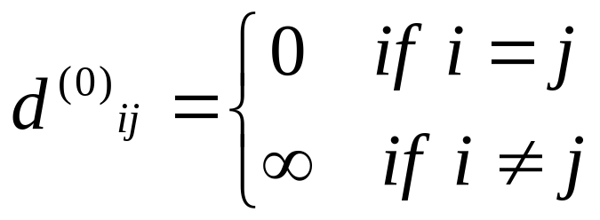
Dynamic programming
Consider the n*n adjacency matrix A=(a_{ij}) of the graph, and define
d^{(m)}_{ij} =weight of a shortest path from i to j that uses at most m edges.
Claim: We have
And for m=1,2,…,n-1: d^{(m)}_{ij}=min_{k}{d^{(m-1)}_{ik}+a_{kj}}

Slide 6
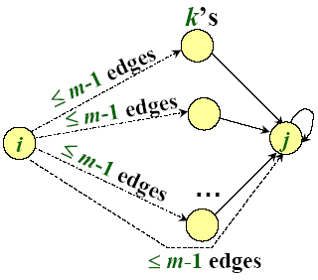
Proof of claim
d^{(m)}_{ij}=min_{k}{d^{(m-1)}_{ik}+a_{kj}}
Relaxation:
for k ← 1 to n
do if d_{ij}>d_{ik}+a_{kj}
then d_{ij}←d_{ik}+a_{kj}
Note: No negative-weight cycles implies
δ(i,j) = d^{(n-1)}_{ij}=d^{(n)}_{ij}=d^{(n+1)}_{ij}=…

Slide 7
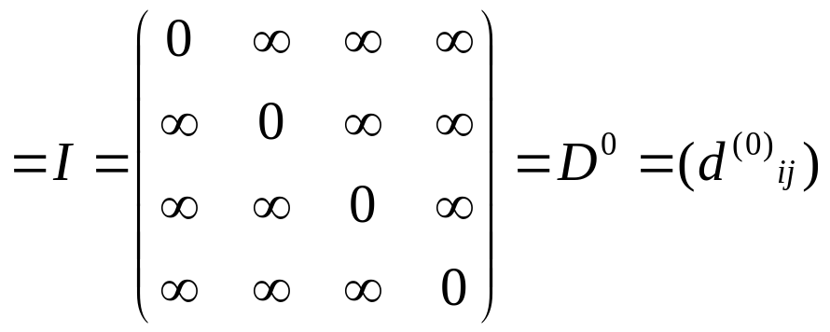
Matrix multiplication
Compute C=A·B, where C,A, and B are n*n matrices:
c_{ij}=∑_{k=1..n}a_{ik}b_{kj}
Time=Θ(n³) using the standard algorithm.
What if we map “+”→ “min” and “.”→ “+”?
c_{ij}=min_{k}{a_{ik}+b_{kj}}
Thus, D^{(m)}=D^{(m-1)} “×” A.
Identity matrix

Slide 8
Matrix multiplication (cont.)
The (min,+) multiplication is associative, and with the real numbers, it forms an algebraic structure called a closed semiring.
Consequently, we can compute
D⁽¹⁾=D⁽⁰⁾·A=A¹
D⁽²⁾=D⁽¹⁾ ·A=A²
…
D^{(n-1)}=D^{(n-2)} ·A=A^{n-1}
yielding D^{(n-1)}=(δ(i,j)).
Time=Θ(n·n³)=Θ(n⁴). No better than n× B-F.
Notes:
Closed semiring：闭半环

Slide 9
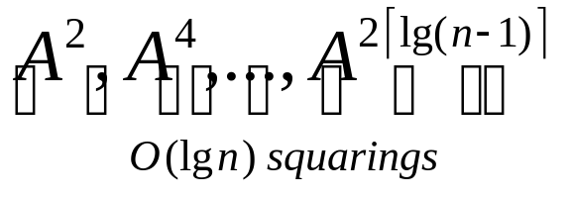
Improved matrix multiplication algo.
Repeated squaring: A^{2k}=A^{k}*A^{k}
Compute
Note: A_{n-1}=A_{n}=A_{n+1}=….
Time=Θ(n³lgn)
To detect negative-weight cycles, check the diagonal for negative values in O(n) additional time.

Slide 10
Simple Review
Bellman-Ford algorithm
  O(VE)
All-pairs shortest paths
  d^{(m)}_{ij} = min_{k}{d^{(m-1)}_{ik}+a_{kj} }
  (min,+) multiplication
  Improved matrix “multiplication” algorithm.

Slide 11

Floyd-Warshall algorithm
Also dynamic programming, but faster!
Define c_{ij}^{(k)} weight of a shortest path from i to j with intermediate vertices belonging to the set {1,2,…,k}
Thus, δ(i,j)=c_{ij} ^{(n)}. Also, c_{ij} ⁽⁰⁾=a_{ij} .

Slide 12
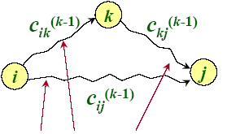
Floyd-Warshall recurrence
c_{ij}^{(k)}=min_{k}{c_{ij}^{(k-1)},c_{ik}^{(k-1)}+c_{kj}^{(k-1)}}
Intermediate vertices in {1,2,…,k}

Slide 13
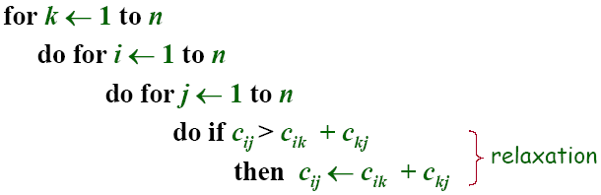
Pseudocode for Floyd-Warshall
Notes:
-- Okay to omit superscripts, since extra relaxations can’t hurt.
-- Runs in O(n³) time
-- Simple to code
-- Efficient in practice

Slide 14
Floyd-Warshall algorithm
C⁰(i,j)=A(i,j)
6
1
2
3
v₁
4
v₂
1
0
4
11
11
A=
2
2
6
0
2
3
v₃
3
3
∞
0
1
2
3
C⁰ =A=
1
0
4
11
2
6
0
2
3
3
∞
0

Slide 15
Floyd-Warshall algorithm
C^{k}(i,j)=min{C^{k-1}(i,j),C^{k-1}(i,k)+C^{k-1}(k,j)}
6
1
2
3
v₁
4
v₂
1
0
4
11
11
C⁰=
2
2
6
0
2
3
v₃
3
3
∞
0
1
2
3
⇒C¹ =
1
0
4
11
2
6
0
2
3
3
7
0

Slide 16
Floyd-Warshall algorithm
C^{k}(i,j)=min{C^{k-1}(i,j),C^{k-1}(i,k)+C^{k-1}(k,j)}
6
1
2
3
v₁
4
v₂
1
0
4
11
11
C¹=
2
2
6
0
2
3
v₃
3
3
7
0
1
2
3
⇒C² =
1
0
4
6
2
6
0
2
3
3
7
0

Slide 17
Floyd-Warshall algorithm
C^{k}(i,j)=min{C^{k-1}(i,j),C^{k-1}(i,k)+C^{k-1}(k,j)}
6
1
2
3
v₁
4
v₂
1
0
4
6
11
C²=
2
2
6
0
2
3
v₃
3
3
7
0
1
2
3
⇒C³ =
1
0
4
6
2
5
0
2
3
3
7
0

Slide 18
Floyd-Warshall algorithm
C^{k}(i,j)=min{C^{k-1}(i,j),C^{k-1}(i,k)+C^{k-1}(k,j)}
6
1
2
3
v₁
4
v₂
C⁰ =A=
1
0
4
11
11
2
6
0
2
2
3
3
3
∞
0
v₃
1
2
3
1
2
3
1
2
3
1
0
4
11
1
0
4
6
1
0
4
6
C¹ =
C²=
C³ =
2
6
0
2
2
6
0
2
2
5
0
2
3
3
7
0
3
3
7
0
3
3
7
0

Slide 19
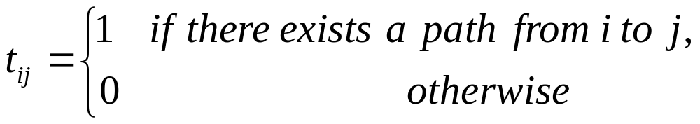
Transitive closure of a directed graph
Compute
IDEA: Use Floy-Warshall, but with (∨,∧) instead of (min, +)
t_{ij} ^{(k)}=t_{ij} ^{(k-1)} ∨(t_{ik}^{(k-1)} ∧t_{kj} ^{(k-1)})
Time=O(n³)

Slide 20
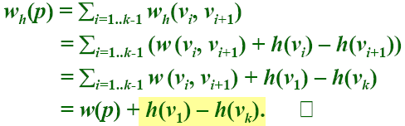
Graph reweighting
Theorem. Given a function h: V→R, reweight each edge (u,v) ∈E by w_{h}(u,v)=w(u,v)+h(u)-h(v).
Then, for any two vertices, all paths between them are reweighted by the same amount.
Proof. Let p=v₁→v₂→…→v_{k} be a path in G. We have
same amount

Slide 21
Shortest paths in reweighted graphs
Corollary. δ_{h}(u,v)=δ(u,v)+h(u)-h(v).□
IDEA: Find a function h: V→R, such that w_{h}(u,v) ≥0 for all (u,v) ∈E. Then run Dijkstra’s algorithm from each vertex on the reweighted graph.
NOTE: w_{h}(u,v) ≥0 iff h(v)-h(u) ≤w(u,v)

Slide 22
Johnson’ algorithm
1. Find a function h: V→R, such that w_{h} (u,v) ≥0 for all (u,v) ∈E by using Bellman-Ford to solve the different constraints h(v)-h(u) ≤w(u,v), or determine that a negative-weight cycle exists.
--Time=O(VE).
2. Run Dijkstra’s algorithms using w_{h} from each vertex u∈V to compute δ_{h}(u,v) for all v ∈V
--Time=O(VE+V²lgV)
3. For each (u,v)∈V*V, compute
δ(u,v)=δ_{h}(u,v)-h(u)+h(v)
--Time=O(V²)
Time=O(VE+V²lgv)

Slide 23
Johnson’ algorithm
Johnson’ algorithm
JOHNSON(G) 1 compute G’, where V[G’] = V[G]∪{s} E[G’] = E[G]∪{(s,v): v∈V[G],and w(s,v)=0 for all v∈V[G] if BELLMAN-FORD(G’,w,s) = FALSE then print “the input graph contains a negative-weight cycle” else for each vertex v∈V[G] do set h(v) to the value of δ(s,v) computed by the Bellman-Ford algrithom for each edge (u,v)∈E[G] do w’(u,v)← w(u,v) + h(u) – h(v) for each vertex u∈V[G] do run DIJKSTRA(G,w’,u) to compute δ’(u,v) for all v∈V[G] for each v∈V[G] do d_{uv} ← δ’(u,v) + h(v) – h(u)
h(v)≤ h(u) + w(u,v) ；
0≤w(u,v) + h(u) - h(v) ；

Slide 24
Homework
25.1-1, 25.2-1

